Slide 1
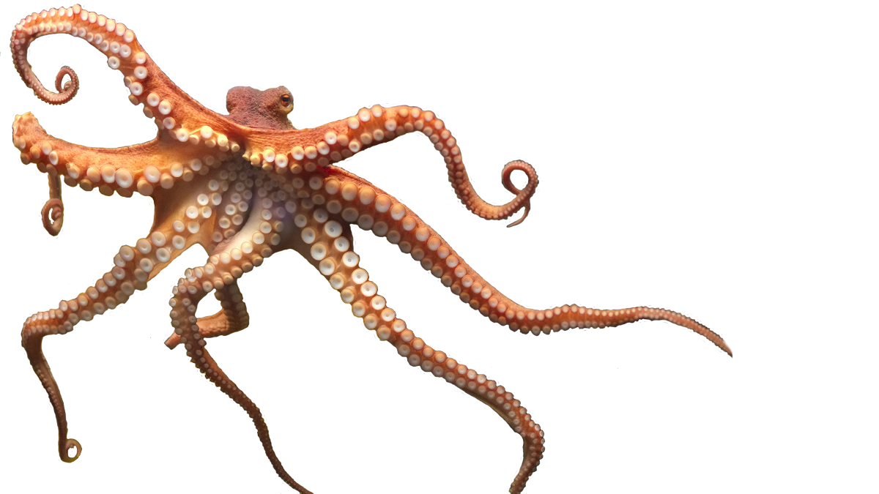
octo-sync
Application to synchronizing files and folders across computer systems

Slide 2
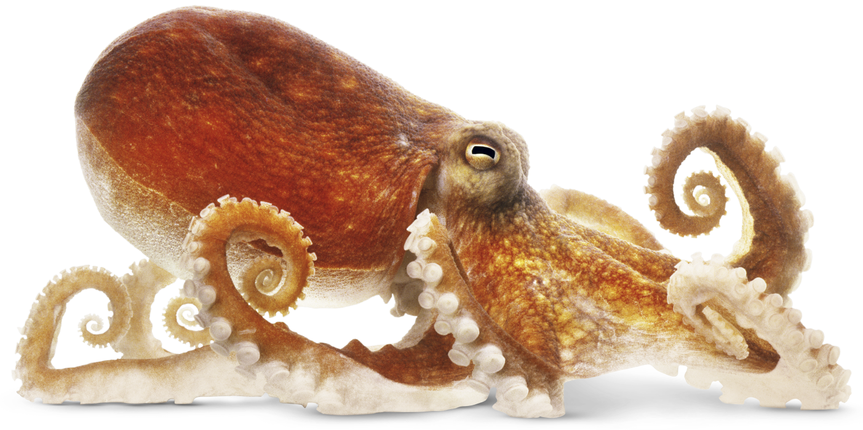
Let’s say you want to have your project in two different computers, while you are writing it
Your options, on Linux:
Copy everything to a flash drive or disk every time you need to synchronize;
Ridiculous;
Use a cloud software such as Google Drive or Dropbox:
Requires internet connection;
Limited Storage space;
You are litteraly giving away your precious files to some private company;
Some are not available for Linux Systems;
Version Management systems such as Git:
High learning curve;
Not automatic: you need to commit, pull, push...;
Mostly for programmers, not very general purpose;
Transfer with commands like scp and cp:
Writing the same (long) command every f****g time you need to transfer something;
These commands just copy files, they do not delete files and folders too;
So you need a way for the files and folders to be synchronized

Slide 3
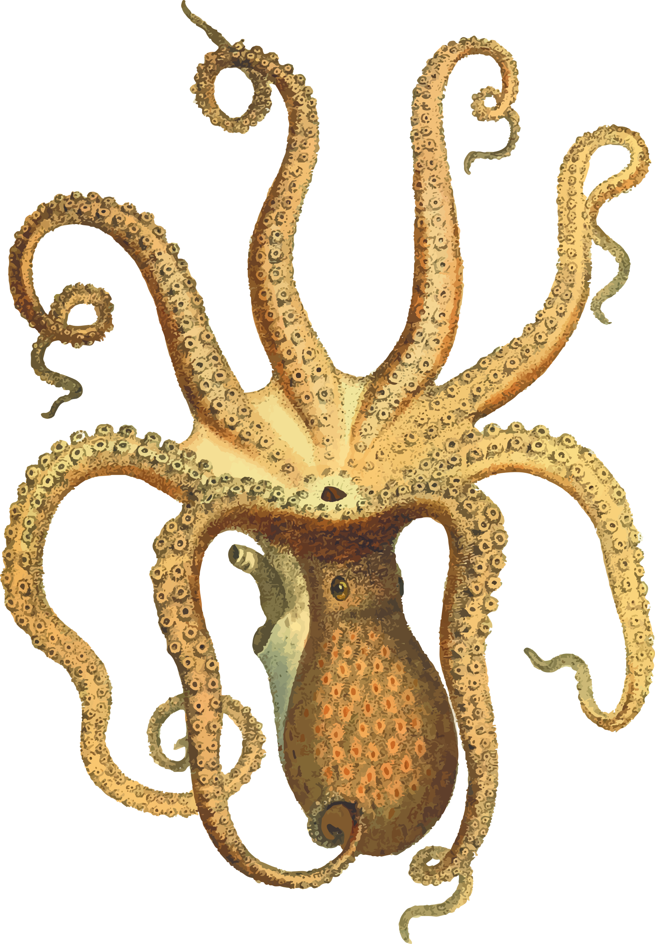
A new option: octo-sync!

Slide 4

What is it?
Octo-Sync is a computer program capable of automatically synchronizing a folder in different computers, connected through a network.
Once you change or create a file/folder in the folder you want to synchronize, Octo-Sync will automatically transfer it to the other computer.

Slide 5

Steps:
Install it;
Open it on the folder you want to synchronize, to start hosting it;
Open it on the other computer, which will synchronize with the host;
Do what you want inside the folder, Octo-Sync will take care of the rest;

Slide 6
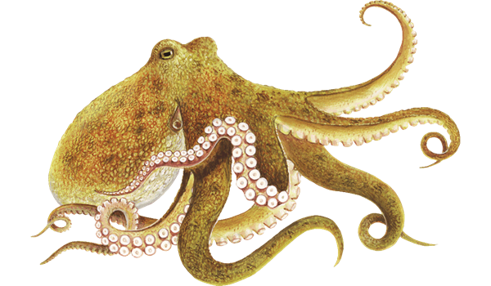
Quick guide
Packages required:
scp, sshpass and openssh-server (to receive scp from the other machine)
$ ./octo-sync host hostAddress=[local-ip-address] hostPasswd=[a password]
The host will wait for a connection from other computer on the network:
$ ./octo-sync sync hostAddress=[host-ip-address] hostPasswd=[same password from above]
There are more command line options that you can use, but these are the basics.
$ ./octo-sync -h
Installation:
$ git clone https://github.com/pentalpha/octo-sync.git
$ cd octo-sync
$ make

Slide 7
Quick guide
./octo-sync -h
sync or host
The operation to perform: either host or sync;
The host must be the first instance to be executed, it will wait for a connection;
The sync connects to a host that is waiting for a new connection;
Use [arg-name]=[value] to pass arguments:
* = obrigatory
syncDir
The directory to synchronize. Default = ./;
hostAddress
* Hosting machine ip;
hostPort
Hosting machine port. Default = 50002;
localPasswd
Local machine (sync or host) user password. The remote will use this password on the scp command;
hostPasswd
* Server password of the host. Used to login;
scpPort
Specify a port for the scp command. If not specified, the default will be used;
logLevel
Minimum level of log messages. A lower value means more output. Default = 7;

Slide 8
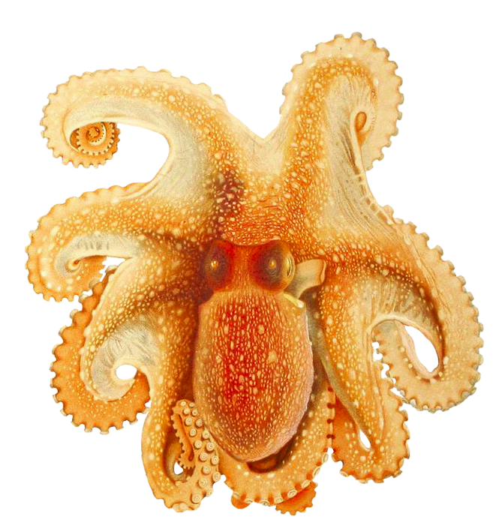
Only 1
That’s the number of times you need to call octo-sync with a lot of arguments. The values of these arguments are stored on .octoConfig file, inside the synchronization folder.

Slide 9

Next: how i built this

Slide 10
steps
Generic purpose Posix socket class, to be implemented by a, also general purpose, Server and Client;
Module to automatically scan folder looking for new files, new folders modifications and deleting: SyncDir;
Command Line Interface: ArgParser and OctoSyncArgs;
A (not-so-simple) finite-state machine: SyncBot
I programmed a lot of different things in a short time to make this project, here are the main ones:

Slide 11
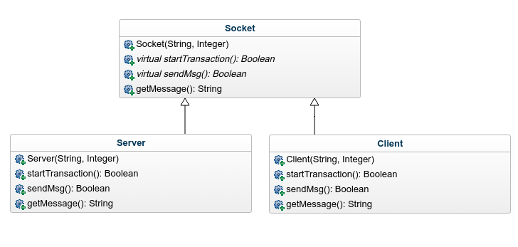
socket
I built a generic purpose socket that can send and receive messages, using threads. The socket left the details on how to start a connection for the Server and Client children classes. This way, it was not necessary to write much server or client specific code.
If I had not done it, the project would have been much more complicated to write.

Slide 12

SyncDir
For a synchronization tool, being able to know what is happening with the files is essential.
SyncDir is a class that monitors a folder. It keeps track of everything: files ans sub-folders.
But it only notifies the changes: modifications, creations and deletions. That is very important for the performance.

Slide 13
CLI interface
For programs that need to be runned remotely or on servers, a graphic interface is not always an option. Octo-Sync is used through a command line interface. It has different behaviour depending on the arguments given. These arguments are given on the form:
./octo-sync [operation] [arg1]=[value1] [arg2]=[value2] [arg3]=[value3]
There is no specific sequence for them and some are mandatory, others not. Some are mandatory, but have default values so they do not need to be specified every time, like syncDir and hostPort.
Another feature is that Octo-Sync stores the last arguments on a file inside the synchronization directory. That means the user only has to type a lot of arguments once.

Slide 14
sync-bot
Before more explanations, I would like to make it clear that there are two main types of synchronization done by SyncBot:
Metadata synchronization;
Data synchronization;

Slide 15
Metadata Synchronization
To know WHEN and IF synchronizing a file/folder is needed, the host or sync instance need to know not only their current files and the last changes: they need to know the same about the machine on the other side too. Both sides (host and sync) have two instances of SyncDir, one for itself and other for the other side.
Based on that data, shared through the network, the data transfers are made.

Slide 16
Data synchronization
SyncBot received its name just because I wanted it to be called like that, its simple and short to write, but while I was writing it the name started to make sense, because it eventually became a finite-state machine.
Only one behaviour is not enough to make everything this class needs to do. It needed more, and more, and more different behaviours:

Slide 17
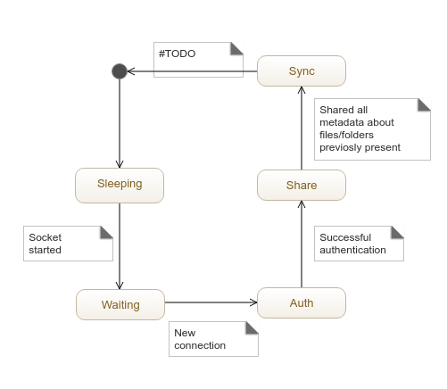
States

Slide 18
Sleeping State
Initial state.
The socket has not yet started, all the SyncBot does is updating SyncDir with the current files and folders.
But, if the server/client is starting, it goes to the next state...

Slide 19
Waiting State
Waiting for a new connection, all the SyncBot does is updating SyncDir with the current files and folders.
But, if the server/client is connected to something, it goes to the next state...

Slide 20
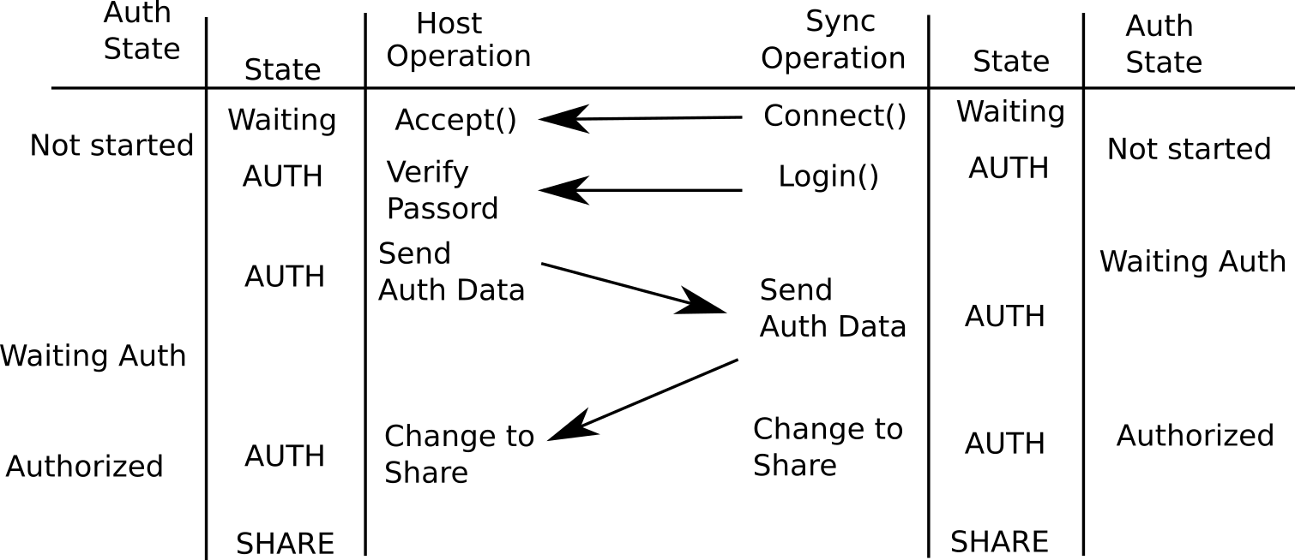
Auth state
This state has a few sub-states, that change with the progression of the communication with the other side

Slide 21
Share State
The local SyncDir is updated, the other SyncBot has connected, logged in and sent his information about username and etc. All ready? Not everything.
The SyncDir that mirrors the local SyncDir on the other SyncBot has not been updated yet. There is no way to know if a file should be transferred or not.
The Share State is for sharing only file metadata, not data. Once all metadata has been shared, a “shared-all” message is sent to the other SyncBot and the next stage starts...

Slide 22
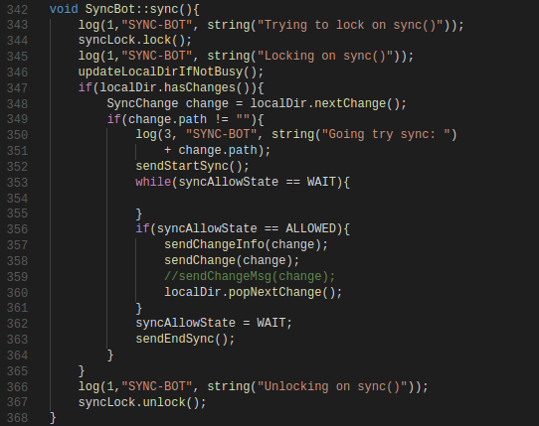
Sync State
Before a synchronization, SyncDir is updated. Then, if there are changes on the change queue, a change is popped and SyncBot tries to send it.
Before sending, it needs the permission of the other SyncBot, and waits for this permission.
Receiving and sending changes CANNOT be done at the same time, or crazy errors happen. That’s why a mutex called syncLock is used.

Slide 23
Not everything that could be done was done, because the time was very short:
Gracefully exiting: Octo-Sync can only be ended with a SigInt or SIGKILL. There is no other easy way to finish it than pressing CTRL+C, killing the process, or disconnecting the other syncbot. Another way is needed to be implemented.
Complete Cycle: The Sync State is perpetuous. It would be nice to, instead of crashing the program when the other SyncBot disconnects, go back to the sleeping state and wait for a new connection;
Trash: Once a file is deleted with octo-sync, there is no going back. A trash folder would make the program more safe. stop using user password: sending the password of the user over the network is not safe at all. Future versions of octo-sync will use ssh keys.
Multiple machines connected to host: why is it called octo-sync, from octopus (animal with many members), if only two sides can synchronize with it? Well… i also plan to do it on the future.

